Slide 1



Heart Attack Prediction using Machine Learning

Slide 2
Introduction
Let me Introduce our Project Heart Attack Prediction using Machine Learning. Heart attacks are the most prevalent health concern that can lead to death and reduce the lifespan of human being these days.
In olden times there were minor cases of heart attacks but now in recent times since the beginning of 21th century the cases of heart attacks have rose rapidly
This sudden increase is due to change in life style habits and due to consumption high of cholesterol foods.`
Nearly 21 million people die annually due to heart attack in the world
An estimate of person’s risk for Heart Attack is important in order to promote his health.

Slide 3
Introduction
Early detection and prediction are crucial to mitigate risks and reduce severity of the Heart attack
Artificial Intelligence and technology are rapidly advancing, they are increasingly being utilized in many of the complex medical surgeries by using Machine Learning Algorithms
Due to advancements in technology huge amounts of data is being generated and stored which is complex and challenging to analyze.
Our project presents an predictive model using machine learning.
Our project aims to serves as a valuable tool in healthcare for identifying high-risk individuals and enabling proactive measures to prevent and mitigate the impact of heart attacks.

Slide 4
LITERATURE SURVEY

Slide 5
S.No | Title & Year | Authors | Tools/ Algorithms used | Description | Advantages | Disadvantages
1 | Machine learning-based heart attack prediction: A symptomatic heart attack prediction method and exploratory analysis [2022] | LIPIKA GOEL,ROHIT GANWAR | Support Vector Machines, Logistic Regression, Naïve Bayes, XG Boost | The comparative evaluation of four machine learning algorithms for the heart disease prediction was carried out in this study. In this investigation, the performance of ML approaches has been better. When data pre-processing was used, XG Boost performed better in the ML technique for the 13 features in the dataset. The training and test score achieved for the XH Boost was highest with the values 91% and 89% respectively. Similar results of 92% accuracy and AUC score of 0.94 was achieved with XG Boost | High accuracy Efficient Handling Robust | Complexity Overfitting ,Less user friendly
2 | Heart Attack Prediction using Machine Learning Approach [2022] | MUHAMMAD RIZWAN, SADIA ARSHAD, HAFSA AJAZ | KNN, Logistic Regression, Neural Networks , SVM | Machine learning was used to predict heart attacks which involved analyzing various health parameters in order to forecast the likelihood of a person experiencing a cardiac event in this study. Several algorithms such as, including K-Nearest Neighbors (KNN), Support Vector Machines (SVM), Random Forest, Logistic Regression, and Neural Network were employed to do this task | Simple , Easy to implement, High accuracy | Complex Less user friendly
3 | A Machine Learning Approach for Heart Attack Prediction [2022] | Sanjay Gour, Punita Panwar, Divya Dwivedi & Chetan Mali | Random Forest, Decision Tree, Gradient Boosting, and Logistic Regression | In this research, various Supervised ML classifiers namely, Random Forest, Decision Tree, Gradient Boosting, and Logistic Regression have been used to deploy a model for Myocardial Infarction prediction. In spite of having many inconsistencies in both the datasets, various feature transformers have been used to improve the consistencies of datasets and to attain an average accuracy equal to 85.5% and a recall rate of 82% in Framingham dataset based on Gradient Boosting classifier. | Automatic select features, uses high dimensional spaces | Sensitive to noisy data Time consuming

Slide 6
S.No | Title & Year | Authors | Tools/ Algorithms used | Description | Advantages | Disadvantages
4 | Heart Attack Risk Prediction Using Machine Learning. [2022] | Amayo Mordecai | Random Forest , SVM, Naïve Baiyes , Logistic Regression | In this research initially data cleaning and data analysis were done and later a model was developed using machine learning algorithms and the best model SVM was used for prediction | It optimize model performance model, It is Interpretable | Overfitting, less user friendly
5 | Prediction and Analysis of Heart Attack using Various Machine Learning Algorithms [2022] | Ochan Sharma | Deep Learning, SVM, Naïve Bayes, Accuracy | In this study various machine learning algorithms and clinical techniques were used to forecast the heart attacks. Due bi classification Support Vector Machine achieved highest accuracy | High accuracy, flexibility | Overfitting, Complex

Slide 7
S.No | Title & Year | Authors | Tools/Algorithms used | Description | Advantages | Disadvantages
6 | Doctor Chatbot: Heart Disease Prediction System [2020] | Sherwin Fernandes Rut Vij Giwas, Preston Alvarez, Macklon Fernandes | Natural Language Processing SVM, k-NN, Naive Bayes & Porter Stemming | In this study chatbot was made to detect & predict the presence of a Heart Disease with the best possible accuracy .Algorithms like KNN, ANN, SVM, Naïve Bayes, Decision tree etc., were conducted on the same dataset to check the accuracy of each algorithm, the tools which are used to make chatbot are Dialog flow, Microsoft Bot Framework, Telegram Bot API, Keyword Based Chatbot was made in order identify keywords which are received as input from the user. | Provides a user friendly environment Easy to access, It is Robust to Overfitting | Not available at free of cost It is vulnerable noisy data
7 | A Hybrid Approach to Develop and Integrate Chatbot in Health Informatics Systems [2020] | Abhijit Chaturvedi Siddharth Srivastava Astha Rai Barrera Sarwar | Natural Language Processing , Decision tree | Chatbot was made for the ﬂexibility and ease in the blood search at the national level. Natural Language Processing was used do that users can look for blood in query format rather than looking upon the web page, It can be useful in emergencies to get result in instance of time. chatbot uses Natural Language Understanding (NLU) to handle messages and process the services. | Real time updates, user friendly environment | Dependency on Data Quality, Requires huge resources

Slide 8
OBJECTIVES
The model predicts heart attack based on input attributes and the model will be trained by using various machine learning algorithms.
Development of a predictive model which is accurate , user-friendly and easily accessible.

Slide 9
Proposed Architecture
Dataset
Data Pre
Processing
Feature Selection
Machine Learning Algorithm Selection
(RF)
Predictive Model (Training & Evaluation)
Integration with Predictive Model
Final Prediction model

Slide 10
PROBLEM STATEMENT
Implementing a predictive model to predict Heart Attack using Machine Learning Approach.

Slide 11
DESIGN AND IMPLEMENTATION

Slide 12
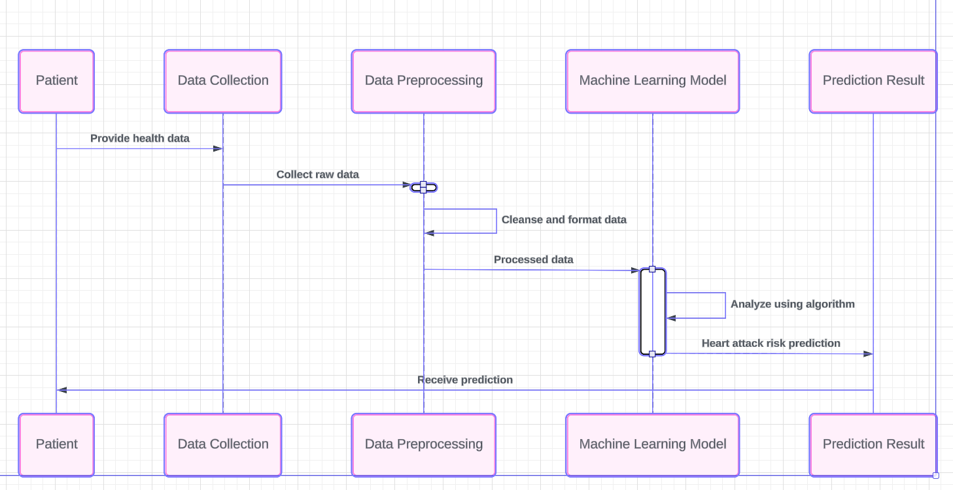
Sequence diagram of Heart Attack Prediction System

Slide 13
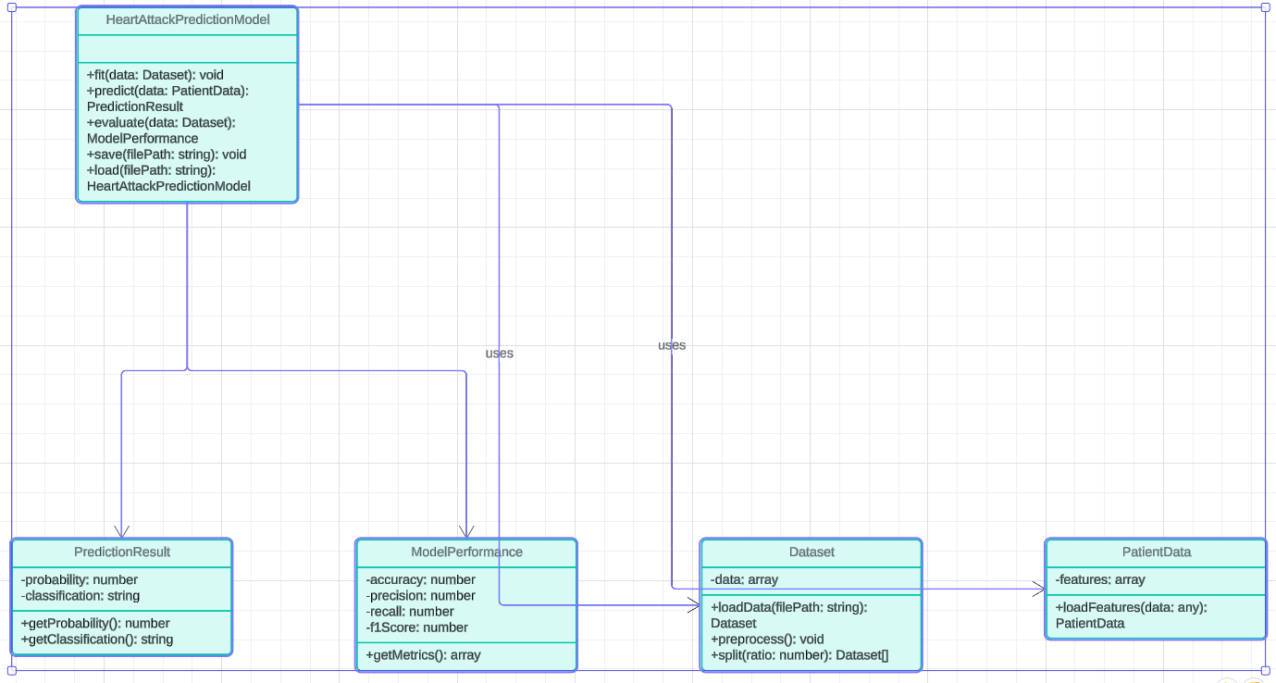
Class Diagram of Heart Attack Prediction System

Slide 14
Heart Attack Dataset
It composed of 1025 patient details and it was obtained from Kaggle.
It composed of many attributes such as Age, Sex , Chest PAIN ,RESTING BLOOD PRESSURE ETC.
Nature of Dataset : Dataset was in structured format and it was in an Excel Sheet.
Number of observations(rows) : 14
Number of attributes (columns): 1026

Slide 15
Attributes used in dataset:
Age
Sex
Chest Pain: ( 4 types)
Typical Angina
Atypical Angina
Non-Anginal pain
Asymptomatic Pain
Resting Blood Pressure
Cholesterol Level
Fasting blood sugar
restecg

Slide 16
Thalach – max heart rate achieved
Slope – slope of the peak exercise
Ca – number of major vessels colored by fluoroscopy

Slide 17
Libraries used
NumPy:
Python library for numerical computations with arrays
.
Pandas:
Data manipulation and analysis tool, offering data structures like DataFrame.
Matplot :
Comprehensive plotting library for creating static, interactive, and animated visualizations.
Seaborn:
Statistical data visualization based on Matplotlib, offering aesthetically pleasing and informative graphics.
Sklearn:
Machine learning library providing tools for classification, regression, clustering, and more, built on NumPy, SciPy, and Matplotlib.

Slide 18
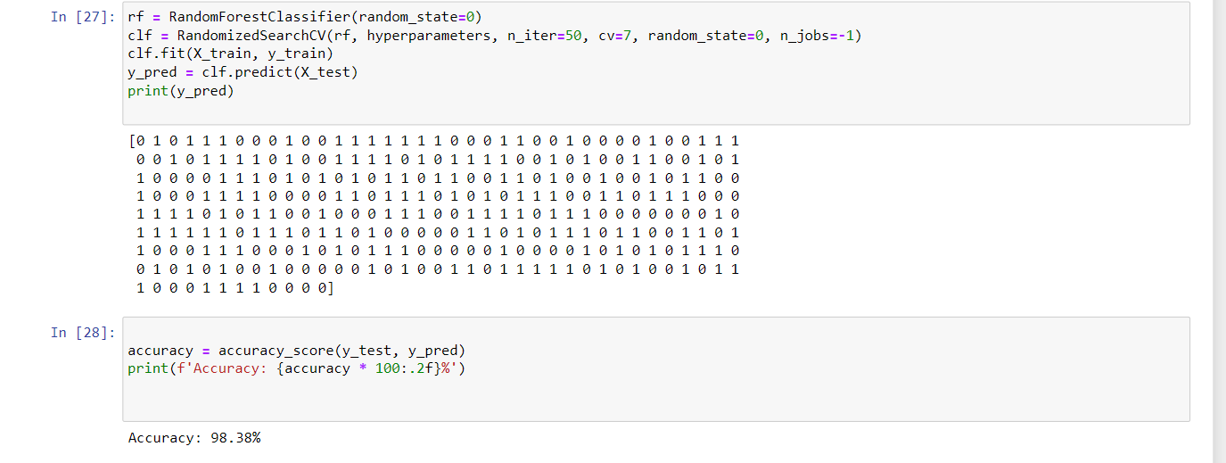
Random Forest Expected Output:

Slide 19
CONCLUSION
The proposed model utilizes a machine learning algorithm to detect heart attacks by analyzing patient details.
Accuracy obtained is 98%(approximately) , and hence performance of model has been improved.

Slide 20
THANK YOU

